Slide 1

Taught By:
Daniel Opoku (Ph.D.)
EE 288 (ELECTRICAL) MEASUREMENT
& INSTRUMENTATION
CONTACT
c/o:
Address: Department of Electrical Engineering
KNUST, Kumasi, Ghana
E-mail: dopoku.coe@knust.edu.gh
Phone: 0553604143
Office: Opposite COE Department (Temp)
Semester 2, 2016/2017

Slide 2
Introduction
Introduction to Measurement and Instrumentation:
Sensors, Transducers, Actuators, Noise/Error Sources, Analysis and Mitigation, Accuracy and Precision, Classification of Instruments, Analog and Digital Instrumentation System’s Components.
Measurement of Electrical Quantities:
Operation Principles and Dynamic Analysis of Indicating Analog Instruments, Moving Coil and Moving Iron Instruments;
Voltage and Current Measurement: Ammeters and Voltmeters Operation Principles and Range Extension, Digital and Analog Multimeters; Instrument Transformers;
Measurement of Impedance/Resistance: A.C. and D.C. Bridges;
Energy and Power Measurement: Dynamometer Wattmeter and Single-Phase Induction type Wattmeter/Energy Meter, Three-Phase Power Measurement, Power Factor Measurement, Frequency Measurement;

Slide 3
Introduction
Measurement of Non-Electrical Quantities:
Measurement of Strain, Pressure, Liquid Level and Flow, Humidity, mechanical displacement/distance, Cathode Ray Oscilloscope, Linear and Angular Velocity and Acceleration;
Micro-Electro-Mechanical (MEMS) Sensors.
Data Acquisition, Recording and Analyses:
Digital Data Acquisition System (DAQ) Components (Hardware and Software), Logic and Spectrum Analyzers.
SCADA Systems and Remote Metering.
Phasor Measuring Units

Slide 4
Introduction
Materials
Major Reference: Lecture Notes/Slides, One Book
Other References: Measurement and Instrumentation (Theory and Application) By Alan S. Morris and Reza Langari
- Job Prospects: Automation Engineer/Instrumentation Engineer/Measurement Engineer/Control Engineer/Etc.

Slide 5
History of Measurements
Measurement units were first used in barter trade to quantify the amounts being exchanged and to establish clear rules about the relative values of different commodities.
Such early systems of measurement were based on whatever was available as a measuring unit.
Measuring length: the human torso was used which gave us the hand, the foot, and the cubit as units.
Challenges: Such measurement units are imprecise, varying as they do from one person to the next.
Therefore, there has been a progressive movement toward measurement units that are defined much more accurately.

Slide 6
History of Measurements
The use of meter for measuring unit for length was part of the early improvements.
One meter was defined as 10⁻⁷ times the polar quadrant of the earth.
A platinum bar made to this length was established as a standard of length in the early part of the 19th century.
In 1889, manufactured from a platinum–iridium alloy.
In 1960, a standard meter was redefined in terms of 1.65076373106 wavelengths of the radiation from krypton-86 in vacuum.
In 1983, the meter was redefined yet again as the length of path traveled by light in an interval of 1/299,792,458 seconds.
In a similar fashion, standard units for the measurement of other physical quantities have been defined and progressively improved over the years.

Slide 7
History of Measurements
Establishment of standards for the measurement of physical quantities proceeded in several countries at broadly parallel times;
Several sets of units emerged for measuring the same physical variable.
E.g. Length : yards, meters, or several other units.
Besides, subdivisions of standard units of length exist
E.g. feet, inches, centimeters, and millimeters,
Each has a fixed relationship between each fundamental unit and its subdivisions.
These fixed relationship between these units are left as a assignment for the students.

Slide 8
Systems of Measurement
The Imperial system: Units such as Yards, feet, and inches for length.
Characterized by having varying and cumbersome multiplication factors relating fundamental units to subdivisions
1760 (miles to yards), 1 Mile = 1760 Yards
3 (yards to feet), 3 Feet = 1 Yard
12 (feet to inches), 12 Inches = 1 Foot.
The metric system: Units such as meter, centimeter and millimeter for length.
Characterized by simple multiplication factors relating fundamental units to subdivisions.
All multiples and subdivisions of basic metric units are related to the base by factors of 10
Derived units such as velocity have rather confusion alternative ways in the metric system.

Slide 9
Systems of Measurement
Thus the internationally agreed set of standard units (SI units or Syste`mes internationales d’unite ́s) has been defined,
Efforts are being made to encourage the adoption of this system throughout the world.
However, the Imperial system is still widely used in the engineering industry, particularly in the United States.

Slide 10
Systems of Measurement
Thus the internationally agreed set of standard units (SI units or Syste`mes internationales d’unite ́s) has been defined.
It has seven fundamental units from which all other units are derived.
Efforts are being made to encourage the adoption of this system throughout the world.
However, the Imperial system is still widely used in the engineering industry, particularly in the United States.

Slide 11
Systems of Measurement
Physical Quantity | Standard Unit | Definition of Standard Unit
Length | Meter | Length of path traveled by light in an interval of 1/299,792,458 seconds
Mass | Kilogram | Mass of a platinum–iridium cylinder kept in the International Bureau of Weights and Measures, Sevres, Paris
Time | Second | 9.192631770 10⁹ cycles of radiation from vaporized cesium 133 (an accuracy of 1 in 10¹² or one second in 36,000 years)
Temperature | Degrees | Temperature difference between absolute zero Kelvin and the triple point of water is defined as 273.16 K
Current | Amphere | One ampere is the current flowing through two infinitely long parallel conductors of negligible cross section placed 1 meter apart in vacuum and producing a force of 2x10 ⁻⁷ newtons per meter length of conductor
Luminous intensity | Candela | One candela is the luminous intensity in a given direction from a source emitting monochromatic radiation at a frequency of 540 terahertz (Hzx10¹²) and with a radiant density in that direction of 1.4641 mW/steradian (1 steradian is the solid angle, which, having its vertex at the centre of a sphere, cuts off an area of the sphere surface equal to that of a square with sides of length equal to the sphere radius)
Matter | Mole | Number of atoms in a 0.012-kg mass of carbon 12

Slide 12
Systems of Measurement
(a) Fundamental Units
Quantity | Standard Unit | Symbol
Length Mass Time Electric current Temperature Luminous Matter | Meter Kilogram Second Ampere Kelvin Candela Mole | m kg s A K Cd mol
(b) Supplementary Fundamental Units
Quantity | Standard Unit | Symbol
Plane angle Solid angle | radian steradian | rad sr

Slide 13
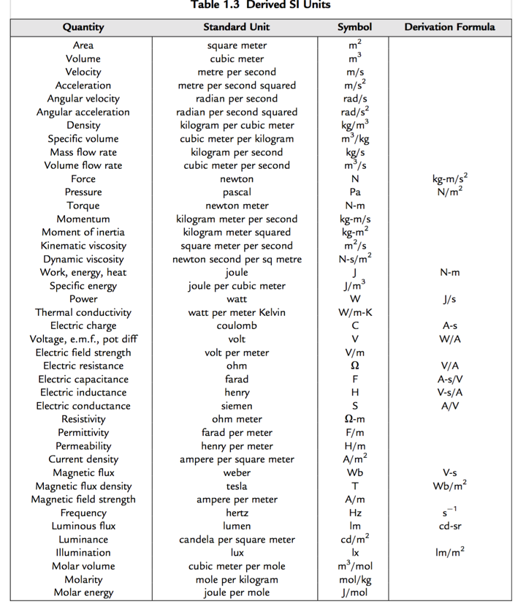
Systems of Measurement

Slide 14
CALCULATION OF COMPLEX POWER
THANK YOU
AND
ALL THE BEST

